Slide 1

Open your Storystack box
There are 24 numbered characters and you can choose who will play which part in your storytelling (or you can follow suggestions on the website)

Slide 2
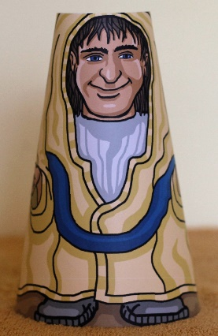
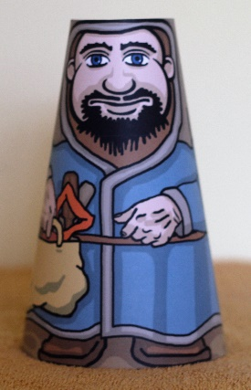
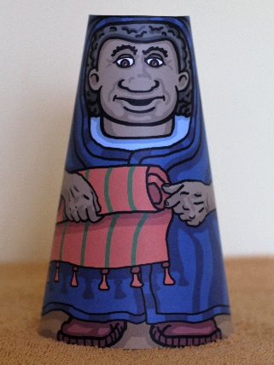
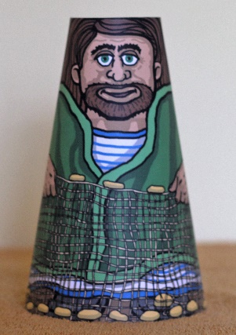
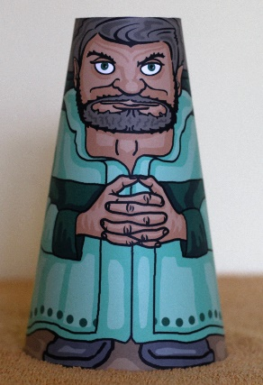
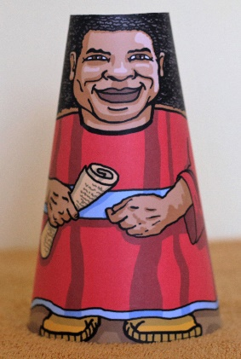
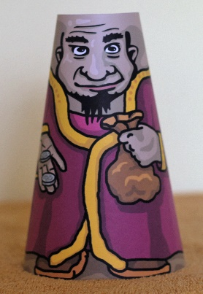
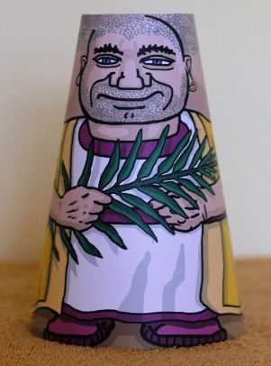
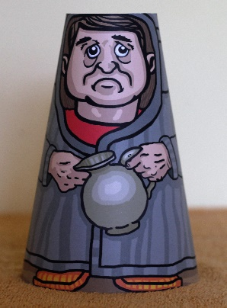
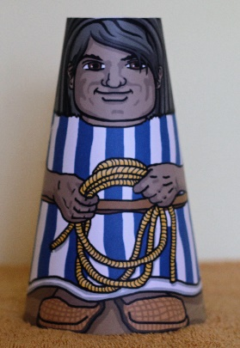
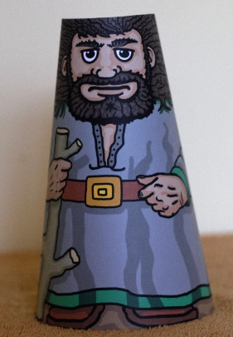
Right – let’s tell the story of the grateful man (Luke 17:11-19)
There are 11 people in this story:
Jesus – represented here by figure 1
10 men with leprosy – represented here by figures 5-14

Slide 3
Do you need some scenery , animals or props?
In this case, perhaps a road and some distant ‘houses’ (boxes) as the men with leprosy were outside the village. A blanket, sheet, curtain or towel can act as a backdrop.
To show that the 10 men had a skin disease, a friend of mine came up with the idea of adding small pieces of blu-tack to the faces and hands which can easily be removed when they are healed on their way to see the priest.

Slide 4
Print out the story or find the children’s bible you will be reading from
The grateful man (Luke 17)
Jesus travelled around the towns, villages and countryside. Lots of people saw the amazing things he did like healing people of illnesses and they also heard what he was teaching about his Father, God. Sometimes, he taught his small group of disciples – the 12 people he chose to do a special work – they are also called the apostles. Sometimes, he taught big crowds of people. Sometimes he had a special message for just one person.
One day, when Jesus was travelling to Jerusalem through a village, there were ten men who all had a disease called leprosy. They were probably standing together at the edge of the village because nobody else wanted to stand anywhere near them - it was believed that anybody who came near to them would catch the disease from their skin, which also looked really strange. They were standing together but away from everybody else and they were very sad. They stood back and called out:
“Jesus, Master, have pity on us”. (Picture 1)
Jesus went to them and said:
“Go to the priests who work in the temple and show them your skin.” (Picture 2)
They went, which was amazing and showed how much they trusted Jesus because they would not have been allowed near the priest with their leprous skin. As they walked towards the temple, their skin was healed and it looked lovely and healthy again. (Picture 3)
Nine of the men carried on walking but one was so grateful that he went back to Jesus praising God and he threw himself down at Jesus feet, thanking Jesus again and again. This man was from Samaria, a country next to Israel and the Samaritans and the Israelites were not friends. (Picture 4)
Jesus asked:
“Where are the others? Weren’t there ten of you who were healed; where are the other nine?”
Jesus was pleased to see that this man was thanking God for his healing and he said to the man, “Rise and go; your faith has made you well’. It wasn’t just this man’s skin that was changed; the man himself was now one of God’s family.

Slide 5

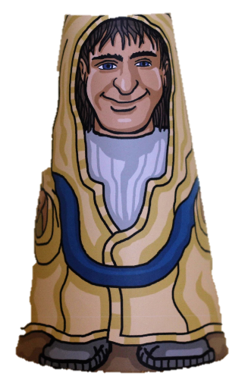
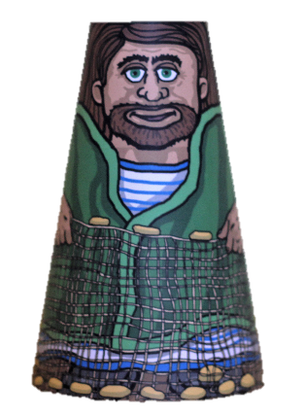
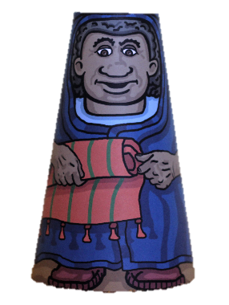
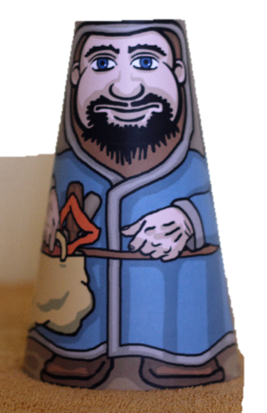
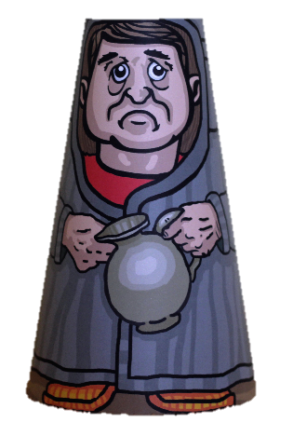
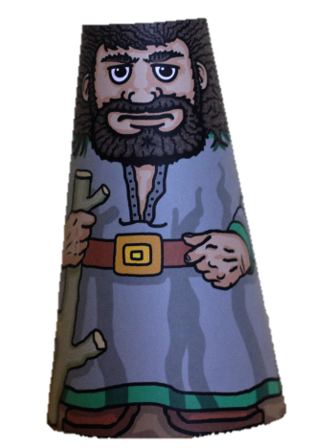
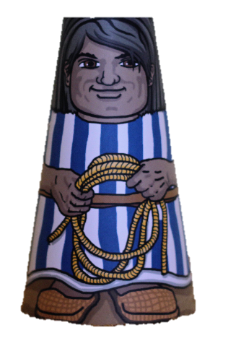
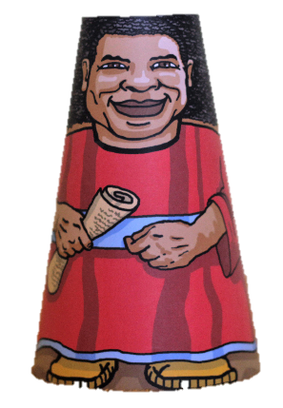
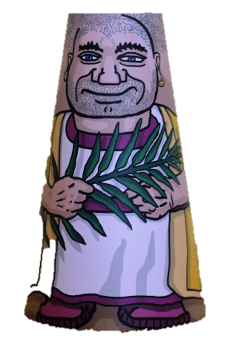
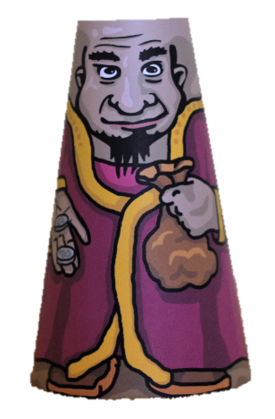

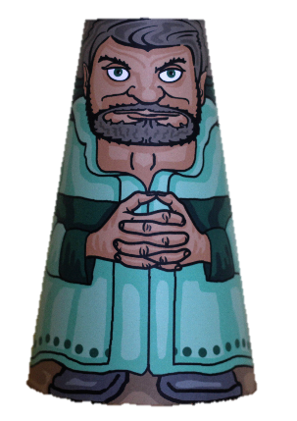

Slide 6


Slide 8



